Slide 1
Secondary Data
Javier Reyna

Slide 2

What is Secondary Data?
Trend Lines
Reference Lines
Annotations
Scales

Slide 3
Trend Lines
Represent the overall nature of the graph
Usually used in graphs that display correlation or time series
Doesn’t represent any actual values but summarized the graph as a whole

Slide 4
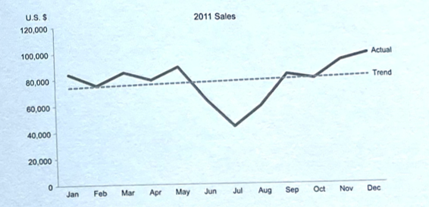
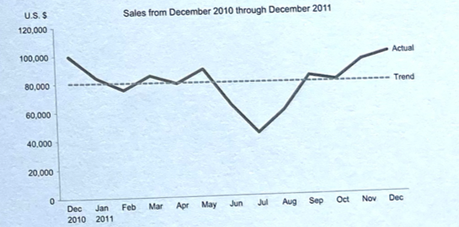
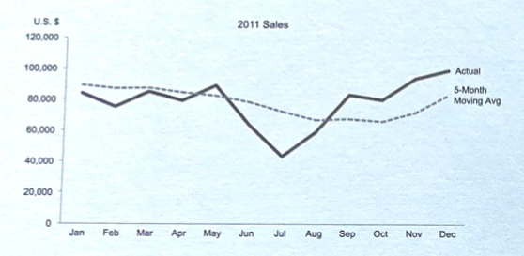
Trend Lines in Time Series

Slide 5
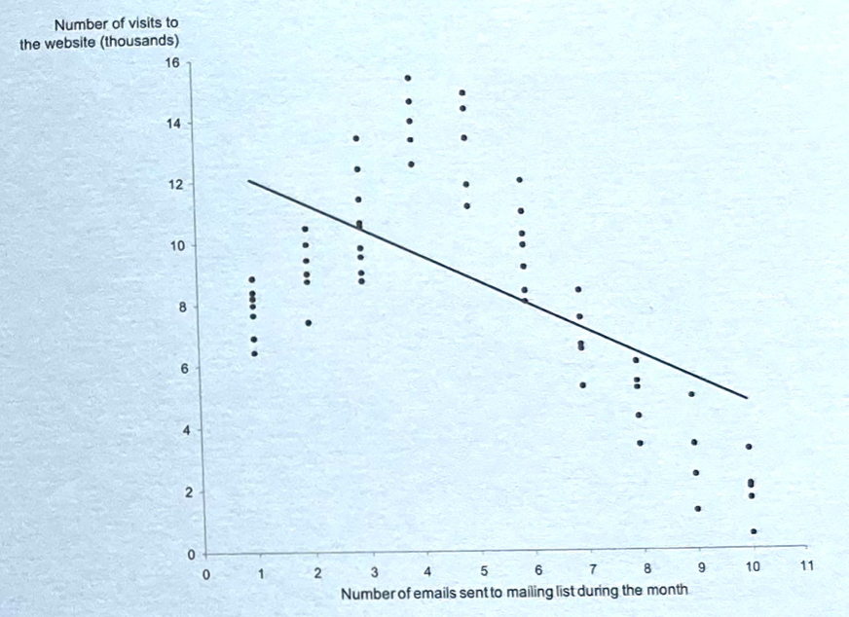
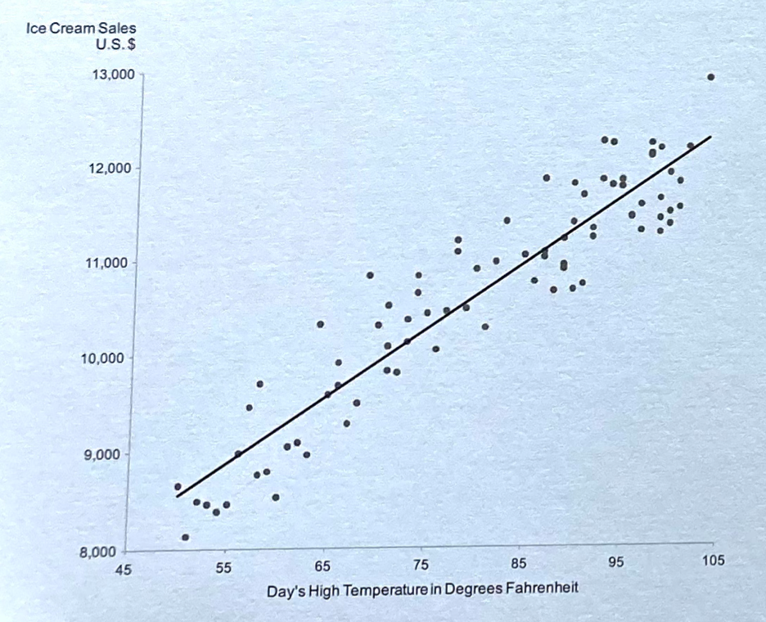
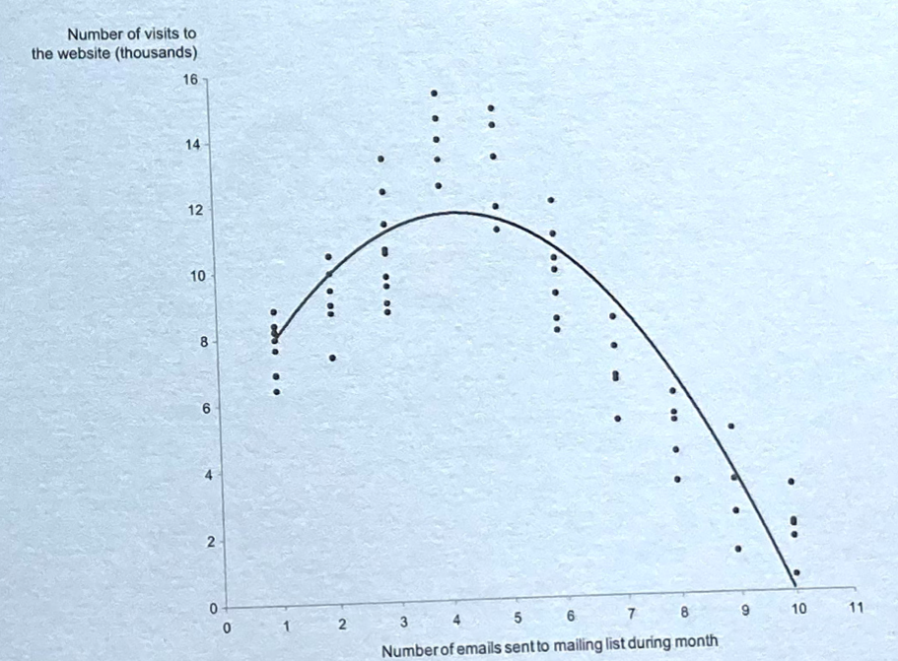
Trend Lines in Correaltions

Slide 6
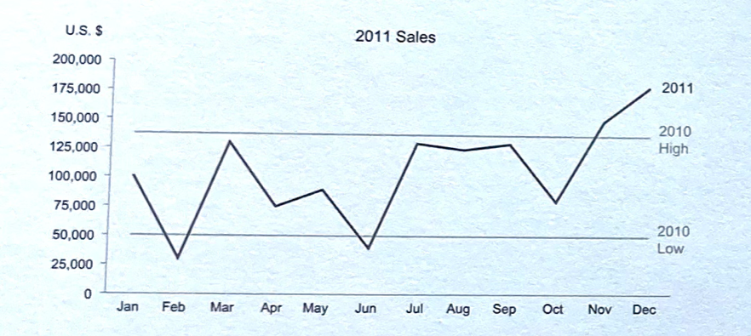
Referance Lines
Provies context information in the form of meaningful comparison

Slide 7
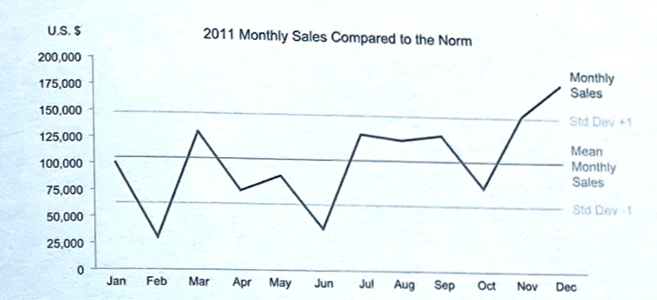
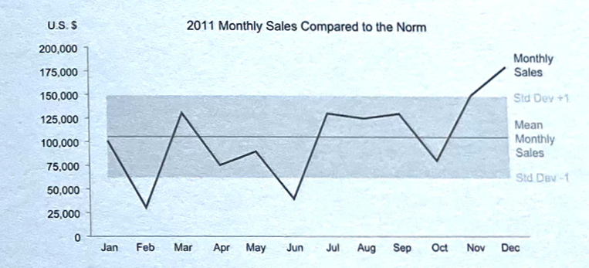
Reference Lines
They can also be helpful to display the mean, median, or standard deviation
This was the reader is able to see how values deviate from the norm

Slide 8
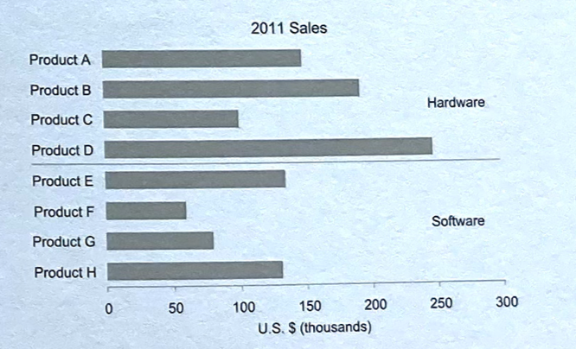
Reference Lines

Slide 9
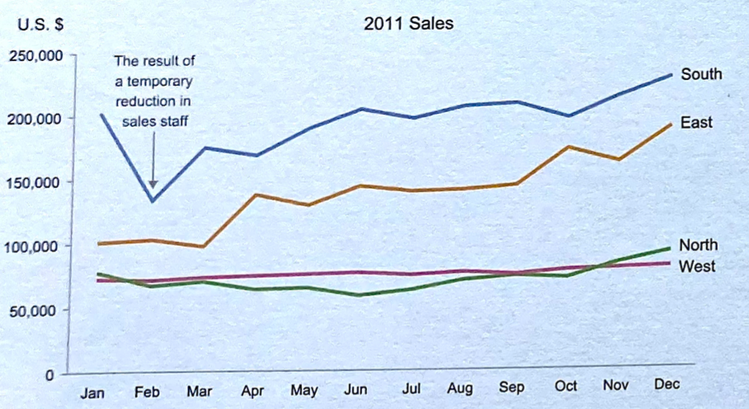
Annotations
They can be used to clarify meaning or to make a point
They should be located in or near the graph
The text should be integrated in a way that doesn’t not distract from the important elements of the graph
If placed in the data region they should not cover or disrupt any information in the data region

Slide 10
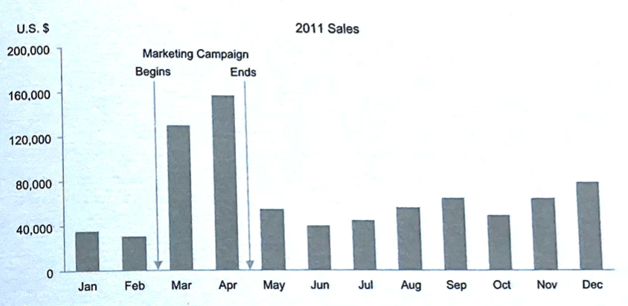
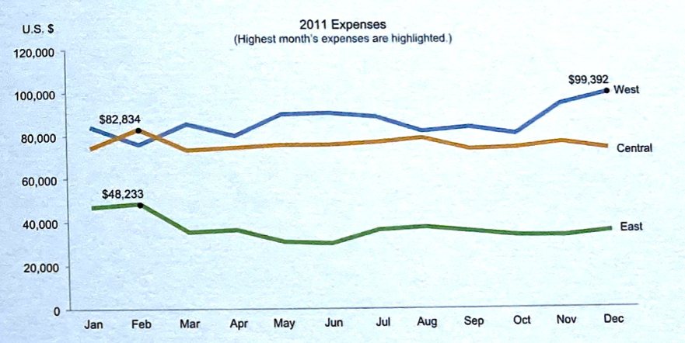
Annotations

Slide 11
Scales
Layed out along the axes of a graph
Divide axes into increments of equal length
Assign quantitive measures or categorical labels to those increments
Quantitative Scales assign specific numeric to the data object
Categorical Scales associate categorical items with data objects

Slide 12
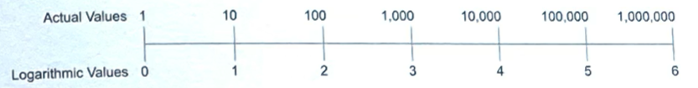
Quantitative Scales
Linear Scale
Logarithmic Scale

Slide 13
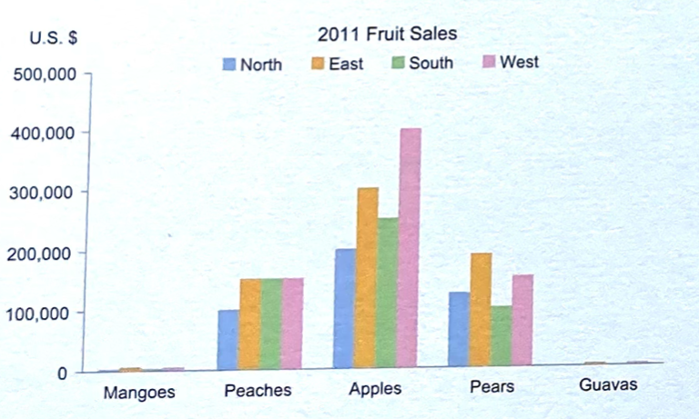
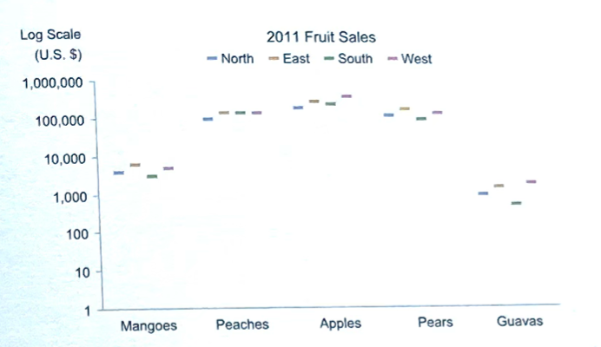
Linear vs Log

Slide 14
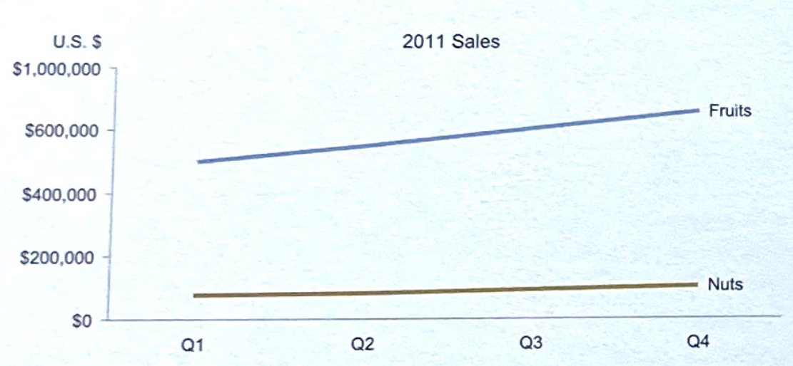
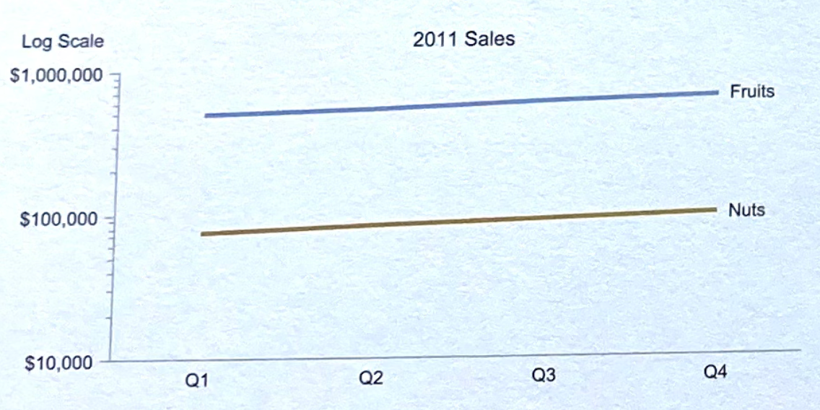
Log Scales
Useful when trying to compare difference in value as a ration or percentage

